Slide 1

AI Based Shelf-Level Inventory Monitoring System
SRM INSTITUTE OF SCIENCE AND TECHNOLOGY
SCHOOL OF COMPUTING
DEPARTMENT DATA SCIENCE AND BUSINESS SYSTEMS
MINOR PROJECT – First Review
Panel head name: Dr T Karthick
Designation: Associate Professor Department: DSBS
Presented by:
K Satwick- RA2311056010314
Durga Sai Gorantla- RA2311050010028
B Venkateswarlu- RA2311050010029
Data Science and Business Systems

Slide 2
Problem Statement
Supermarkets face frequent issues of out-of-stock, misplaced, and unnoticed missing products on shelves.
Inventory monitoring is mostly manual or sales-data based, which is reactive and does not reflect real-time shelf conditions.
Delayed detection of stock issues leads to lost sales, customer dissatisfaction, and increased operational costs.
Existing automated solutions (RFID, smart shelves) are expensive and difficult to implement, especially for small and medium retailers.

Slide 3
Introduction / Background
Retail inventory management is a critical operational challenge in supermarkets and grocery stores.
Traditional methods rely on manual shelf checks or point-of-sale (POS) data, which do not provide real-time shelf visibility.
Most supermarkets already have CCTV cameras installed, but they are primarily used for security purposes.
Advances in Artificial Intelligence and Computer Vision (e.g., YOLOv8) enable real-time object detection from video streams.
This creates an opportunity to transform existing CCTV infrastructure into an intelligent shelf-level inventory monitoring system.

Slide 4
LITERATURE SURVEY
S No. | Title | Methodology | Limitations/Gaps
1. | IEEE (Doc ID: 8963979) Vision-based retail shelf monitoring | Static cameras Classical CNN-based object detection Shelf region segmentation Offline image processing | Not real-time (batch processing) Limited scalability across multiple aisles No integration with backend inventory systems Assumes fixed product placement
2. | IEEE (Doc ID: 10253237) Smart retail vision systems | Deep learning with multi-camera fusion Cloud-based processing High-end hardware dependency | Expensive deployment Cloud latency Not suitable for small/medium supermarkets
3. | IEEE (Doc ID: 9573939) Shelf stock monitoring via deep learning | CNN feature extraction Shelf emptiness detection Binary stock/not-stock classification | No product-level identification No quantity estimation No POS/inventory linkage
4. | ResearchGate Real-Time Retail Shelf-Stock Detection with YOLOv7 | YOLOv7 for object detection Real-time inference Shelf stock presence detection Accuracy-focused evaluation | Detects presence, not exact count No inventory reconciliation logic No alert mechanism Focuses on detection, not operations

Slide 5
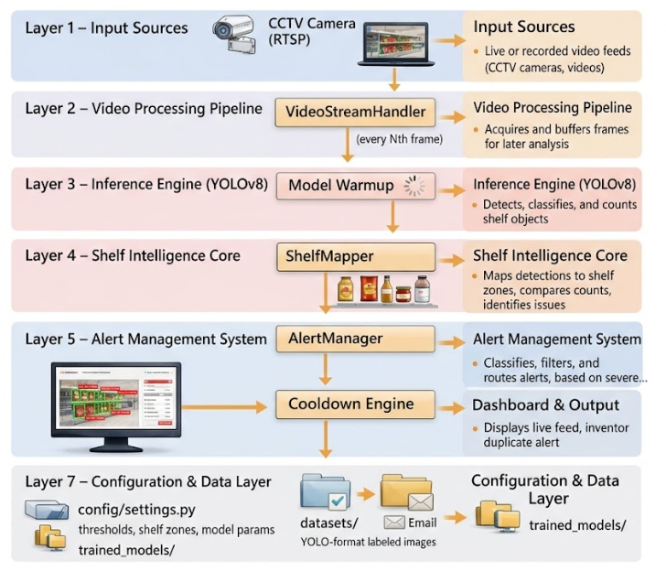
Proposed Methodology

Slide 6
Motivation
Empty or misplaced products on shelves directly result in lost revenue and poor customer experience.
Manual inventory checking is time-consuming, labor-intensive, and prone to human error.
Small and medium retailers cannot afford expensive smart shelf or RFID-based systems.
Existing CCTV cameras are underutilized and can be converted into intelligent monitoring tools using AI.
Leveraging AI for real-time shelf monitoring can make retail operations smarter, faster, and more efficient.

Slide 7

Aligned with Sustainable Development Goals (SDGs)
SDG 9 – Industry, Innovation and Infrastructure
Promotes modernization of retail infrastructure by integrating AI-driven smart inventory monitoring systems.

Slide 8
References
IEEE (Doc ID: 8963979). Vision-Based Retail Shelf Monitoring.
https://ieeexplore.ieee.org/document/8963979
IEEE (Doc ID: 10253237). Smart Retail Vision Systems.
https://ieeexplore.ieee.org/document/10253237
IEEE (Doc ID: 9573939). Shelf Stock Monitoring via Deep Learning.
https://ieeexplore.ieee.org/document/9573939
Real-Time Retail Shelf-Stock Detection with YOLOv7. ResearchGate.
https://www.researchgate.net
Redmon, J., & Farhadi, A. (2018). YOLOv3: An Incremental Improvement.
https://arxiv.org/abs/1804.02767
Jocher, G., et al. (2023). Ultralytics YOLOv8.
https://github.com/ultralytics/ultralytics

Slide 9
THANK YOU

